Slide 1
ULTRASONIC RADAR SYSTEM
Abhishek (22r21a67f3)
varshini (22r21a67f4)
tanuja (22r21a67f7)

Slide 2
INTRODUCTION:-
Radar was firstly developed as a method of detecting enemy aircraft in World War 2.
The aim of this project is to achieve a radar system prototype based on an Arduino board, which detects stationary and moving objects.
Radar is an object detection system that uses microwaves to determine the range , direction, altitude and speed of objects within about a certain radius of their location.
The radar antenna transmits radio waves or microwaves that bounce off any object in their path.
We will be using an Ultrasonic Sensor to determine the presence of any object in a particular range.

Slide 3
CATEGORY:-
Radar system falls under the category of Electronic Systems and Technology.
Specifically, RADAR stands for “Radio Detection And Ranging”.
It is a system that uses Ultrasonic sensors to detect, locate, and track objects such as aircrafts, ships, weather patterns, and even satellites.

Slide 4
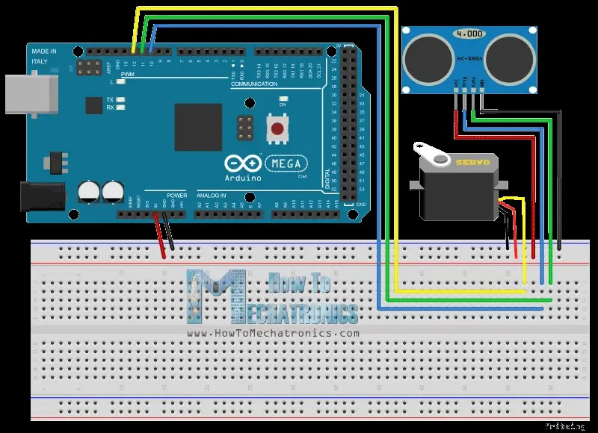
CIRCUIT DIAGRAM:-

Slide 5
COMPONENTS:-
Ultrasonic Sensor HC-SR04.
Servo Motor.
Arduino Board.
Jump wires.

Slide 6
ULTRASONIC SENSOR HC-SR04:-
This economical sensor provides 2cm to 40cm of non-contact measurement functionality with a ranging accuracy that can reach up to 3mm. Each HC-SR04 module includes an ultrasonic transmitter, a receiver and a control circuit.
SERVO MOTOR:-
A servo motor is a self-contained electrical device that moves parts of a machine with high efficiency and great precision. In simpler terms, a servo motor is a BLDC motor with a sensor for positional feedback. This allows the output shaft to be moved to a particular angle, position, and velocity that a regular motor cannot do.

Slide 7
ARDUINO BOARD:-
Arduino board designs a variety of microprocessors and controllers. The boards are equipped with sets of digital and analog input/output (I/O) pins that may be interfaced to various expansion boards ('shields’) or breadboards (for prototyping) and other circuits.
JUMP WIRES:-
A jump wire (also known as jumper, jumper wire, DuPont wire) is an electrical wire, or group of them in a cable, with a connector or pin at each end (or sometimes without them – simply "tinned"), which is normally used to interconnect the components of a breadboard or other prototype or test circuit, internally or with other equipment or components, without soldering.

Slide 8
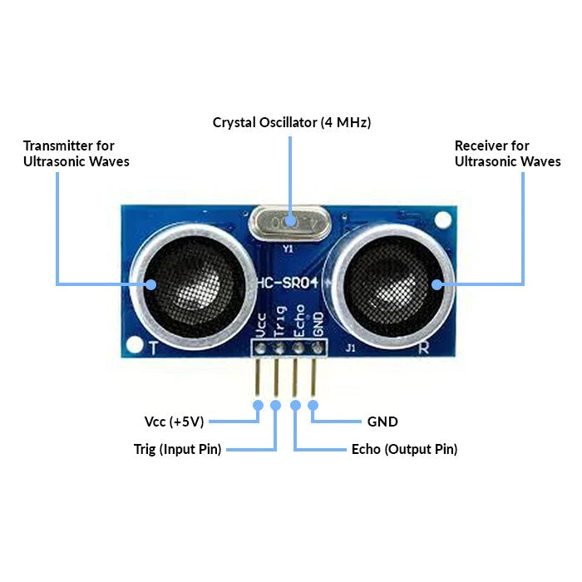
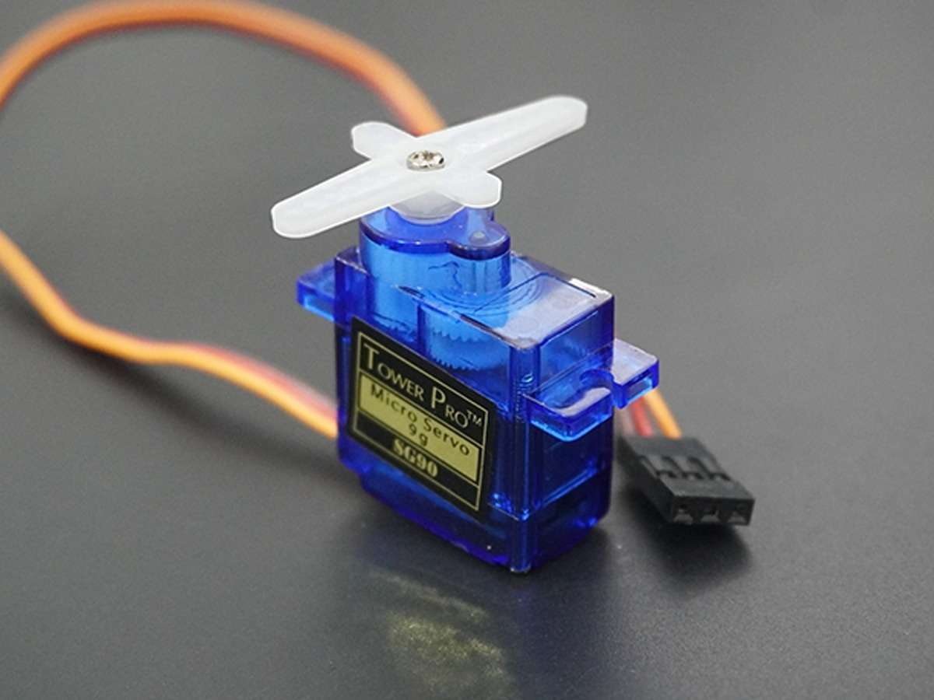
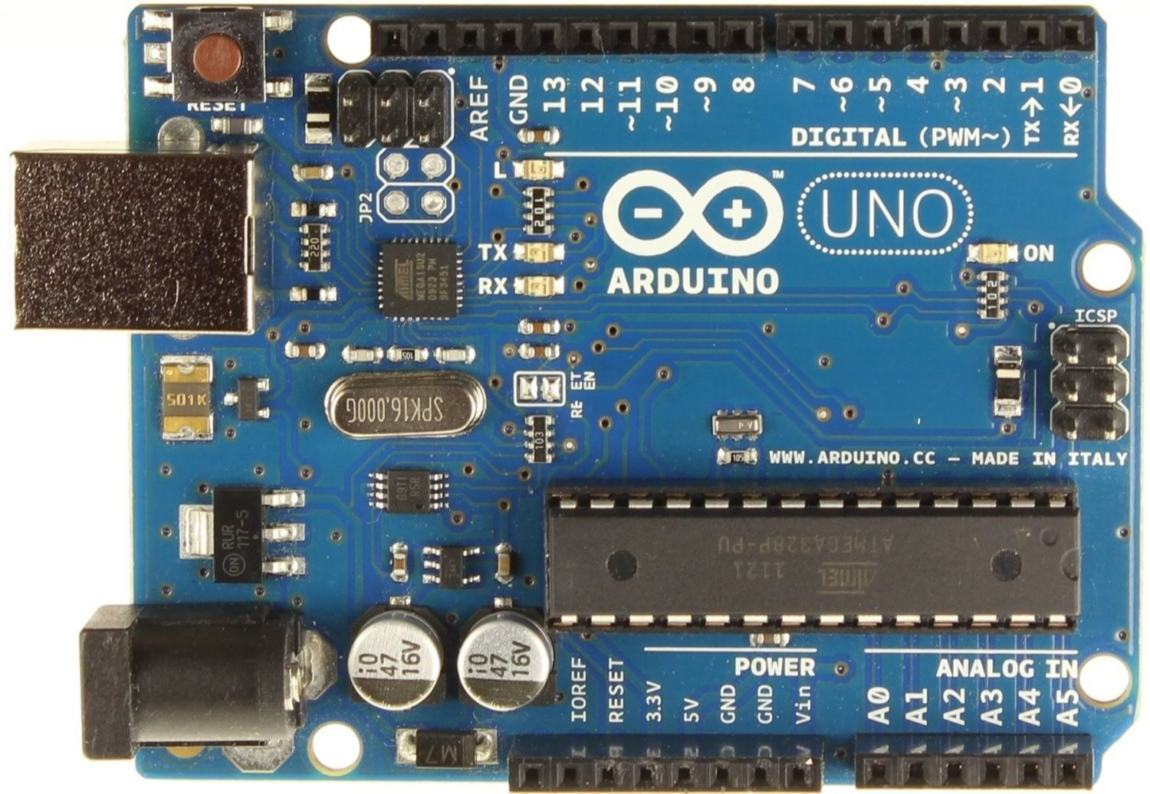
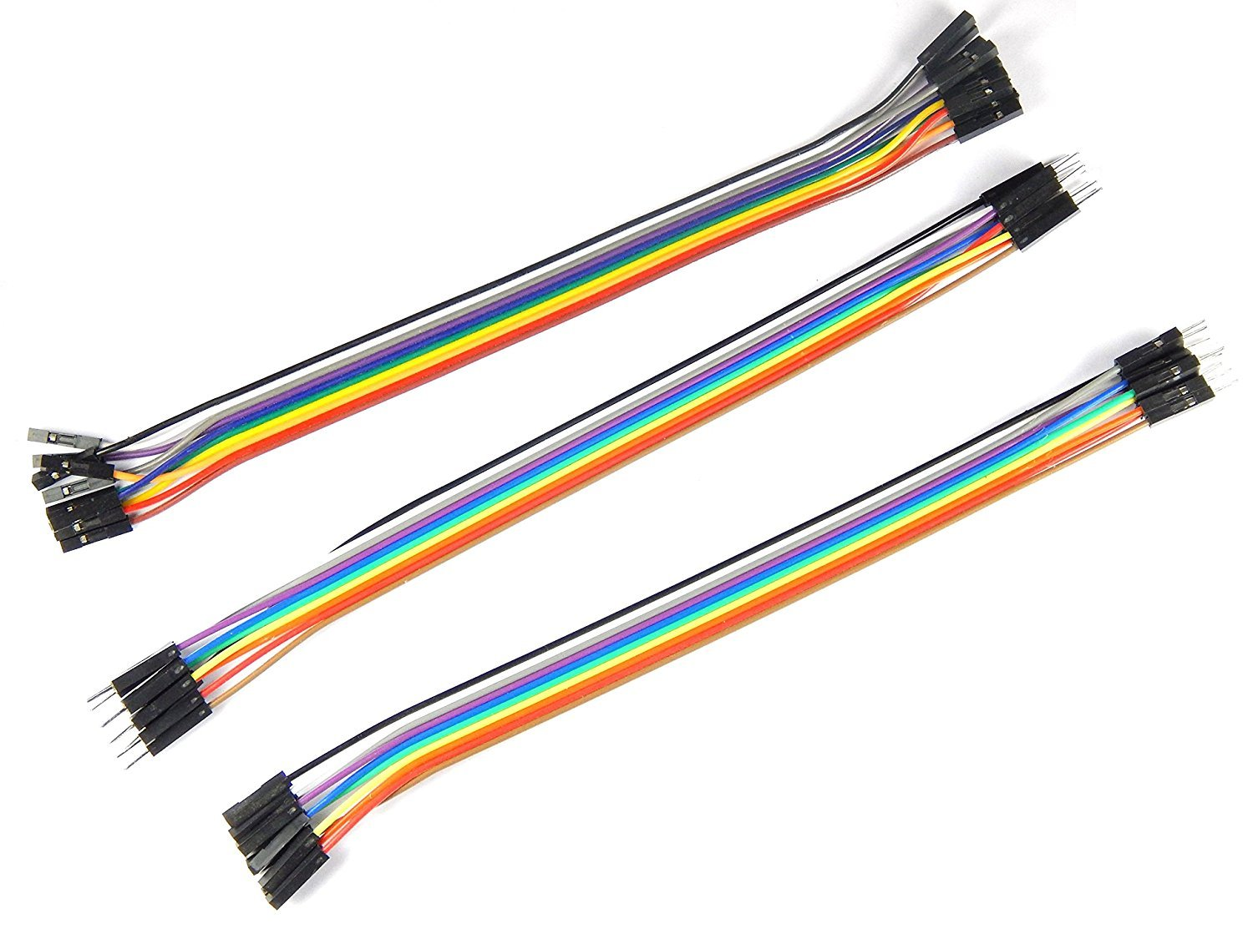

Slide 9
CIRCUIT CONNECTIONS:-
Make a cardboard stand for connecting the Ultrasonic Sensor to the Servo motor.
Fold it, glue it and secure the servo motor using a screw. Also attach a pin header on which we soldered 4 jumper wires, for connecting the sensor.
Connect the Ultrasonic Sensor HC-SR04 to the pin numbers 10 and 11 and the servo motor to the pin number 12 on the Arduino Board. Finally secure the servo motor to the Arduino Board using an elastic band.

Slide 10
APPLICATIONS:-
Parking Sensors: Ultrasonic radar systems are widely used in parking assist systems in vehicles. They help drivers to detect obstacles or objects in their blind spots, providing proximity warnings to avoid collisions during parking or maneuvering.
Object detection: Ultrasonic radar systems are utilized in robotics and autonomous systems to detect and avoid obstacles in their environment. They enable robots or automated vehicles to navigate safely by detecting and responding to nearby objects or barriers.

Slide 11
Medical imaging: Ultrasonic radar systems, commonly known as ultrasound imaging, are extensively used in medical diagnostics. They provide real-time imaging of internal organs, tissues, and structures within the body, aiding in the diagnosis and monitoring of various medical conditions.
Proximity Sensors: Ultrasonic radar systems can serve as proximity sensors in various applications. For example, they can be used in automatic doors to detect the presence of individuals, triggering the door to open or close. They are also utilized in security systems to detect intrusions or unauthorized access to restricted areas.

Slide 12
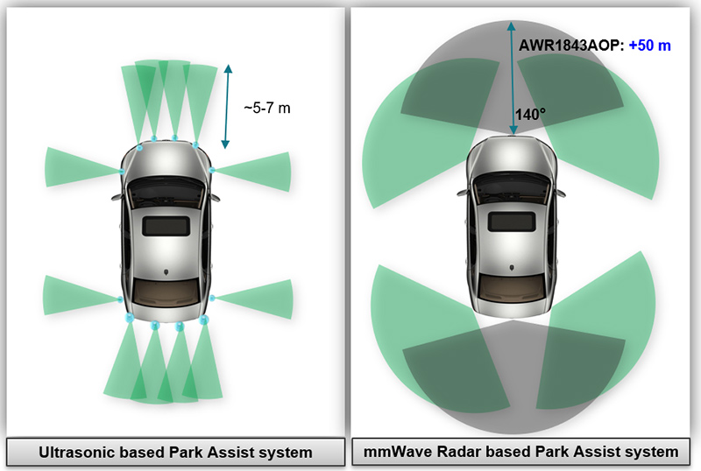
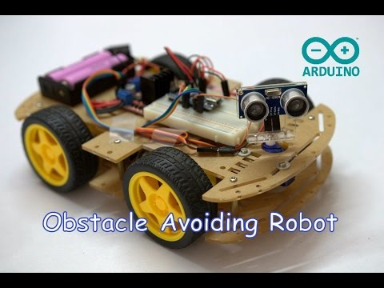
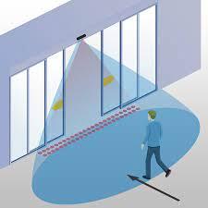
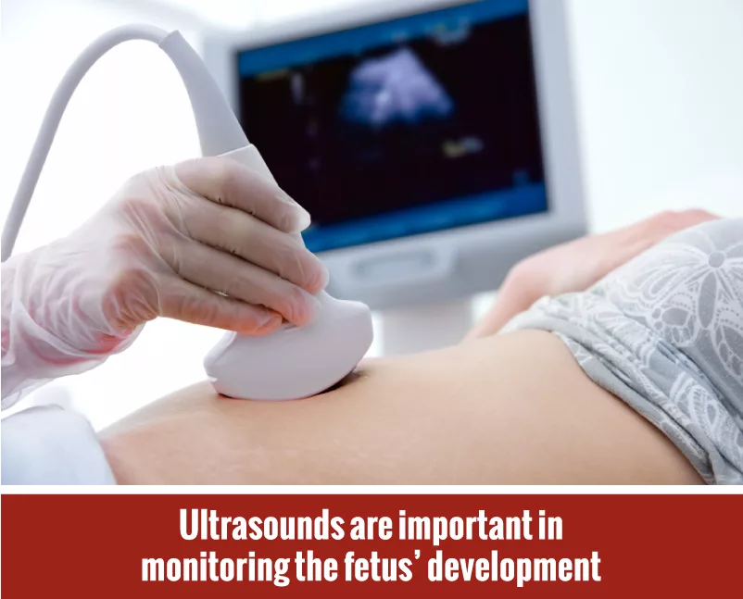

Slide 13
Advantages:-
Non-contact measurements.
High accuracy.
Versatility.
Low cost.
Simple integration.

Slide 14
DISADVANTAGES:-
Limited range.
Susceptible to environment conditions.
Limited resolution.
Interference of other source.

Slide 15
STRENGTHS:-
Non-contact measurements.
High accuracy.
Simple integration.
WEAKNESS:-
Limited range.
Limited resolution.

Slide 16
OPPORTUNITIES:-
Advancements in technology.
Integration with other sensing technologies.
THREATS:-
Competition from alternative technologies.
Rapid technological advancements.

Slide 17
THANK YOU

